Slide 1
EVERYDAY SECURITY
Cybersecurity is everyone’s everyday job
Small choices protect people, accounts, devices, and data.
Notes:
Cybersecurity is part of ordinary work. The safest culture is built through small choices people can repeat every day.

Slide 2



THE PLATFORM
The platform turns awareness into repeatable habits
Short cues, practical actions, and an easy path to ask for help.
Learn in the moment
Practice the basics
Know where to report
Short, timely learning people can use in the moment.
Simple actions across email, accounts, devices, and data.
Clear reporting paths when something feels wrong.
Notes:
The platform concept turns awareness into repeatable behavior: teach a short cue, make the action concrete, and make help easy to find.

Slide 3
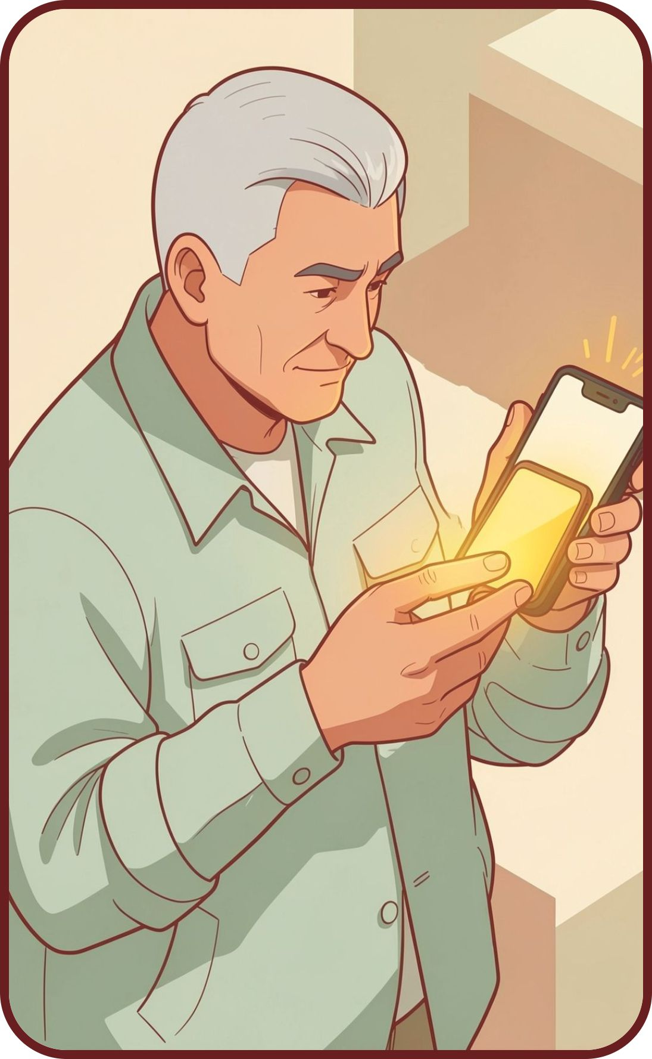
Spot the signals before you click
Phishing uses social engineering to steal credentials or deliver malware.
01
02
03
Pause
Verify
Protect
Stop when a message creates urgency, fear, or unusual pressure.
Check the sender and destination through a trusted channel.
Do not open unexpected attachments or enter credentials from a message link.
Notes:
When a message pushes you to act quickly, make the pause visible. Verify through a channel you trust, and keep credentials away from message links.

Slide 4



ACCOUNT PROTECTION
Protect every account with stronger access
Make the account harder to take over, even when a password is exposed.
Use unique passwords
Aim for 16+
Turn on MFA
Choose long, random, unique passwords and store them in a password manager.
Aim for passwords of at least 16 characters.
Use multifactor authentication wherever it is available.
Notes:
Account protection is a set of habits, not a single setting. A password manager makes unique passwords practical, and multifactor authentication adds another check.

Slide 5
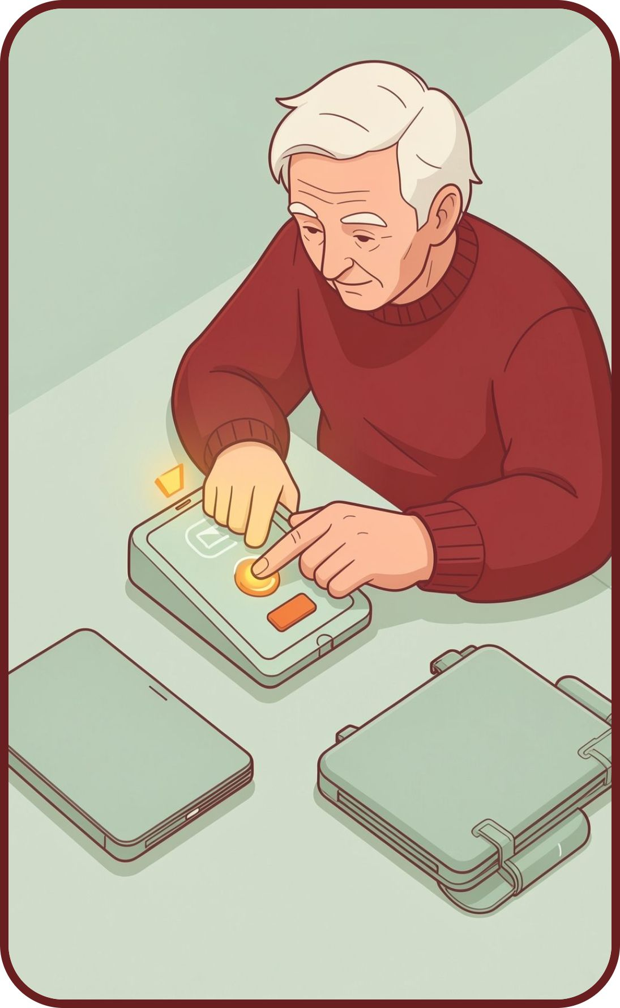
Keep devices ready to defend you
A ready device is easier to trust and easier to protect.
01
02
03
Update promptly
Use approved tools
Lock when you leave
Install software and security updates as soon as they are available.
Choose approved devices, apps, and storage locations.
Lock your screen when you step away.
Notes:
CISA describes updating software as one of the easiest ways to stay protected. Pair that habit with approved tools and a locked screen whenever you step away.

Slide 6




Make safe handling the default
When the safe path is ordinary, sensitive information gets fewer chances to travel the wrong way.
Share with care
Check recipients
Share sensitive information only with the right people and tools.
Check recipients before sending confidential files.
Keep accounts separate
Stop and ask
Keep work and personal accounts separate.
When in doubt, stop and ask.
Notes:
Safe handling is often a small pause before sharing. Check the people, the tool, the recipient, and the account. If the context is unclear, ask before you send.

Slide 7
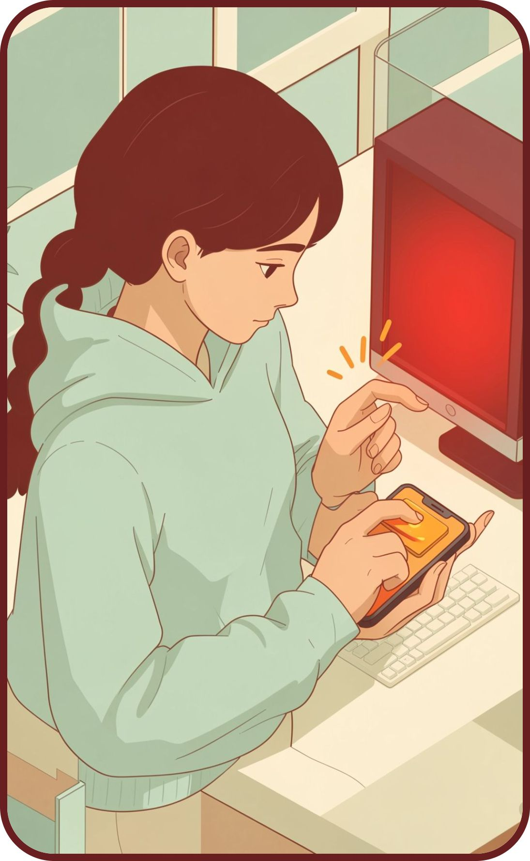
REPORTING IS PROTECTION
Report early, without fear
A fast, factual report gives security or IT a chance to contain the problem and protect colleagues.
01
02
03
Use one click
Share the facts
Help contain it
Use the platform’s one-click reporting path for suspicious messages.
Tell security or IT what happened, what you clicked, and when.
Fast reporting helps contain the problem and protects colleagues.
Notes:
Reporting is a protective action, not an admission of failure. Say what happened, what you clicked, and when. Those facts help the response start quickly.

Slide 8
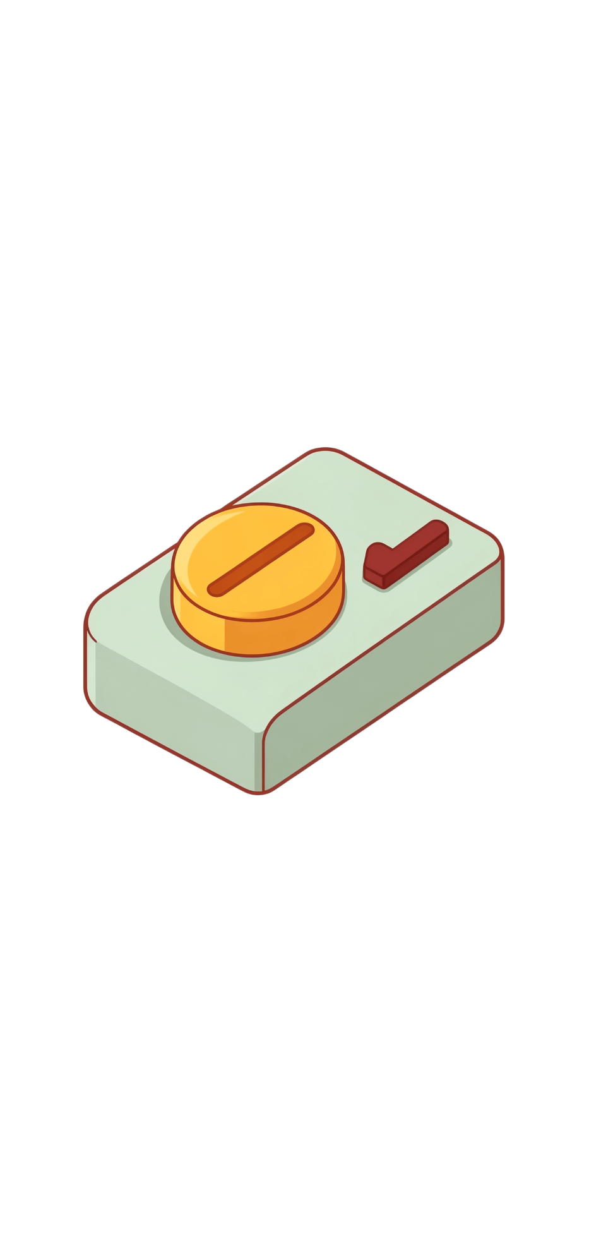



THE ROUTINE
Small actions create a stronger culture
Keep learning
Complete the next short learning module.
Practice the routine
Practice the pause, verify, report routine.
Build confidence
Help teammates build confidence, not fear.
Notes:
Close on the routine: learn a little, pause and verify before acting, report when something feels wrong, and help others feel capable of doing the same.

